Slide 1


Introduction to data management planning as a service
Joy Davidson
Digital Curation Centre

Slide 2
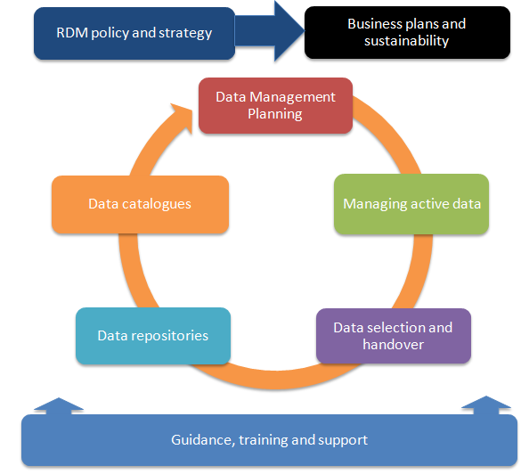
RDM Services
Case studies,
How to Guide
http://www.dcc.ac.uk/resources/developing-rdm-services

Slide 3
Data Management Planning
Research Data Management Landscape
Data Management Planning

Slide 4

“Data sets are becoming the new instruments of science”
Dan Atkins, University of Michigan

Slide 5

Funders’ expectations of public access
“Publicly funded research data are a public good, produced in the public interest, which should be made openly available with as few restrictions as possible in a timely and responsible manner that does not harm intellectual property.”
RCUK Common Principles on Data Policy
http://www.rcuk.ac.uk/research/Pages/DataPolicy.aspx

Slide 6
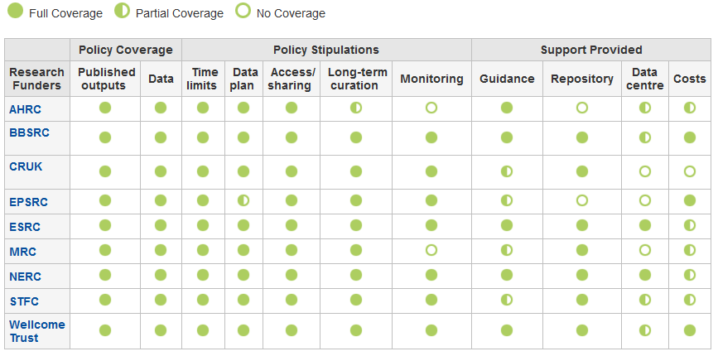
Research funder data policies
www.dcc.ac.uk/resources/policy-and-legal/ overview-funders-data-policies

Slide 7

Ultimately funders expect:
timely release of data
once patents are filed or on (acceptance for) publication
open data sharing
minimal or no restrictions if possible
preservation of data
typically 5-10+ years if of long-term value
See the RCUK Common Principles on Data Policy:
www.rcuk.ac.uk/research/Pages/DataPolicy.aspx

Slide 8

“Research organisations will ensure that effective data curation is provided throughout the full data lifecycle, with ‘data curation’ and ‘data lifecycle’ being as defined by the Digital Curation Centre. The full range of responsibilities associated with data curation over the data lifecycle will be clearly allocated...”
...institutional responsibility
www.epsrc.ac.uk/about/standards/researchdata/Pages/expectations.aspx

Slide 9
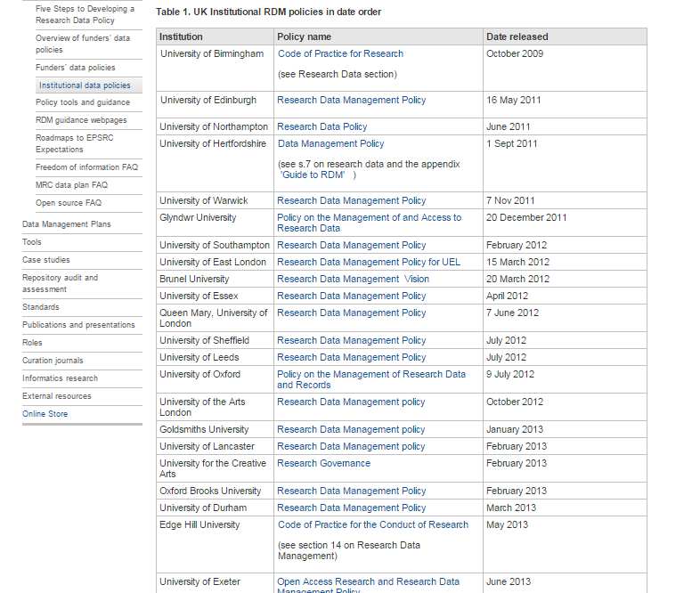
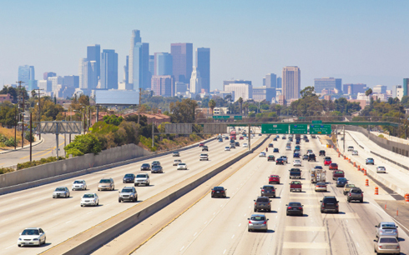
Collecting HEI policies and implementation roadmaps
http://www.dcc.ac.uk/resources/policy-and-legal/epsrc-institutional-roadmaps
http://www.dcc.ac.uk/resources/policy-and-legal/institutional-data-policies

Slide 10
Data Management Planning
Planning to Share
Data Management Planning

Slide 11
What is data sharing?
“… the practice of making data used for scholarly
research available to others.” [Wikipedia]
Who’s involved?
the data sharer
the data repository
the secondary data user
support staff
research participants
commercial partners

Slide 12

Reasons to share data
BENEFITS
Avoid duplication
Scientific integrity
More collaboration
Better research
Increased citation
9-30% increase shown in
study
(Piwowar H. and Vision T.J 2013 , https://peerj.com/preprints/1.pdf)
DRIVERS
Public expectations
Government agenda
RCUK Data Policy
www.rcuk.ac.uk/research/Pages/DataPolicy.aspx
UKRIO Code of Practice for Research
www.ukrio.org/what-we-do/code-of-practice-for-research/

Slide 13
Managing restrictions on sharing
Ethics
Balance data protection with data sharing
Informed consent – cover current and future use
Confidentiality – is anonymisation appropriate?
Access control – who, what, when?
IPR
Clarify copyright before research starts
Consider licensing options e.g. Creative Commons

Slide 14
How to share research data
Use appropriate repositories and data catalogues
http://databib.org
http://www.re3data.org/
Jisc/DCC research data registry (coming soon!)
License the data so it is clear how it can be reused
www.dcc.ac.uk/resources/how-guides/license-research-data
Make sure it’s clear how to cite the data
http://www.dcc.ac.uk/resources/how-guides/cite-datasets
Consider publishing a data paper based on your DMP http://metajnl.com/

Slide 15
What is a DMP?
A short plan that outlines
what data you will create and how
how you will manage it
(storage, back-up, access…)
plans for data sharing and preservation
DMPs are often submitted as part of grant applications, but are useful whenever you’re creating data.
Create
Document
Use
Share
Preserve
Store

Slide 16
Why develop a DMP?
to help you manage your data
to provide guidelines for everyone to work to
to anticipate and avoid problems e.g. data loss
to avoid duplication, data loss & security breaches
to comply with funders requirements...

Slide 17
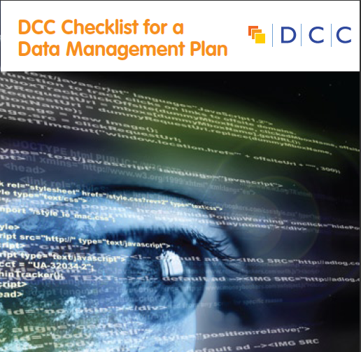
They typically want a short (c.1-2pp) statement covering:
What data will be created (format, types, volume...)
Standards and methodologies to be used (incl. metadata)
How ethics and Intellectual Property will be addressed
Plans for data sharing and access
Strategy for long-term preservation

Slide 18


Data sharing plan
Covering:
Dataset
Standards
Metadata
Preservation
Data sharing
method
timescale
restrictions
agreements
Data Mgmt Plan
Covering:
Data
Data sharing
when?
where?
how?
restrictions?
Preservation
Resources
Data Mgmt Plan
Covering:
Data
Data collection
Management
Security
Data sharing
Responsibilities
Related policies
Admin details

Slide 19
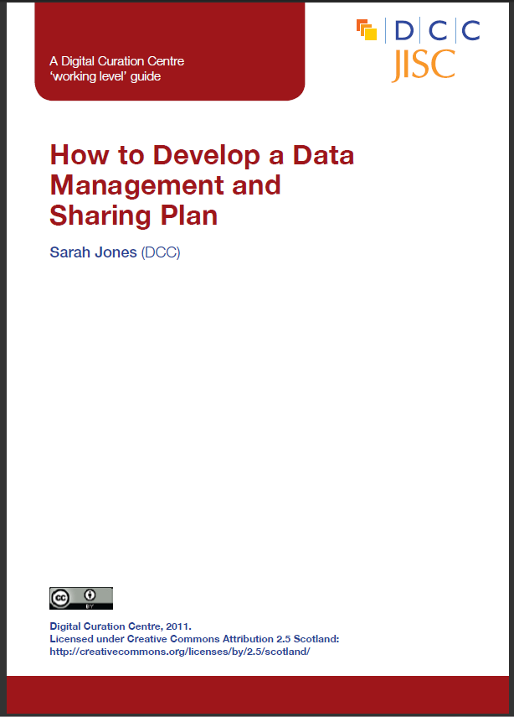

The DCC offers DMP guidance and tools
www.dcc.ac.uk/resources/data-management-plans

Slide 20
Tips for researchers
Encourage researchers to start early - don’t wait until the last minute to develop plan!
Encourage researchers not to write the plan in isolation – they seek advice from colleagues, ethics, IT, library, DP/FoI...
Researchers should be realistic - base plans on available skills & support
The plan will - and should - change over life of project

Slide 21
Considerations for HEI
Will support staff or researchers initiate the plan?
Will you require a copy of the grant stage DMP as part of funding application records?
Will you require a final version of the DMP in your institutional repository?
How will costs associated with RDM services be covered?

Slide 22
Data Management Planning
Research Data Management Costs
Data Management Planning

Slide 23
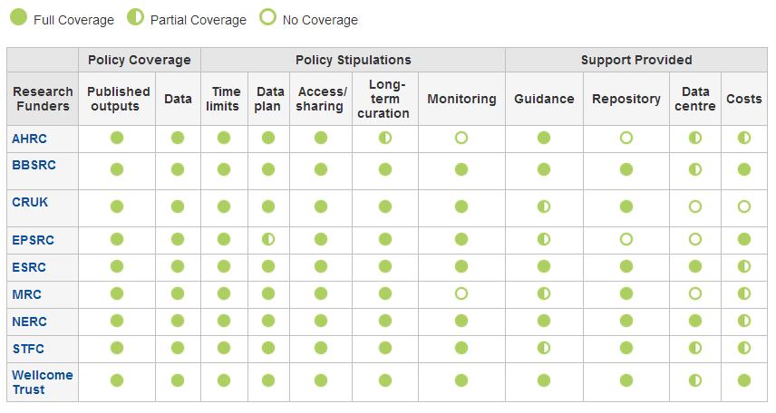
Research funders’ policies
www.dcc.ac.uk/resources/policy-and-legal/overview-funders-data-policies

Slide 24
How should costs be included?
In-project costs should be included in the direct costs for a project
Post-project costs could be direct (e.g. charges levied by data centres) but typically fall into indirects as universities should provide infrastructure to support RDM
The Justifications of Resources should, where possible, separate out the following RDM cost elements:
cost of collecting data
the cost of curating data
the cost of analysing data
the cost of preservation and sharing
Notes:
In-project (direct) costs:
covers hardware, staff, expenses, costs of preparing data & metadata...
Post project (largely indirect) costs:
existing services should be used where possible
where an institution is going to provide a data repository, costs should be met through FEC
outsourcing to a third-party is also an option

Slide 25
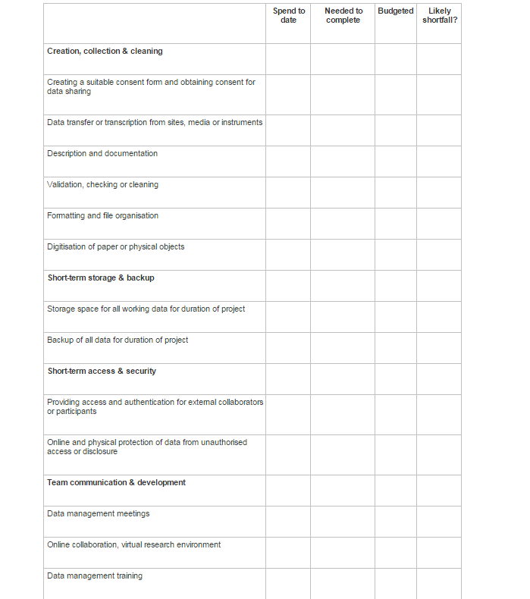
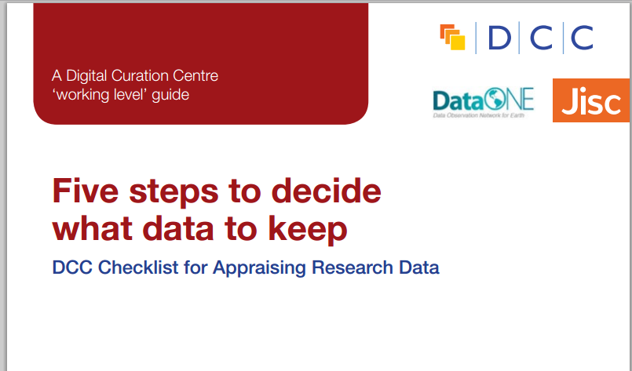
Handy costing checklist in our Five steps to decide what to keep guide
http://www.dcc.ac.uk/resources/how-guides/five-steps-decide-what-data-keep

Slide 26
Key messages
Research data management should not be regarded as optional.
DMPs should make clear what is provided and what activities are being charged against a grant
The cost of RDM is project-specific and entirely depends on the type of work.
It may be possible to set up small research facilities to recover the cost of RDM (e.g. similar to provision of HPC), possibly as a cross-institutional service.

Slide 27
Thanks – any questions? www.dcc.ac.uk joy.davidson@glasgow.ac.uk

